Slide 1
Lifetimes of singly and doubly charmed baryons
Charmed Baryons
Hai-Yang Cheng
Academia Sinica
2nd Workshop on Parton Distribution Functions
November 27, 2018

Slide 2
 | 10⁻¹³s
D⁰_{d} | 4.101±0.015
D⁺ | 10.40±0.07
D⁺_{s} | 5.00±0.07
 | 10⁻¹²s
B⁰_{d} | 1.520±0.004
B⁰_{s} | 1.510±0.005
B⁺ | 1.638±0.004
 | 10⁻¹³s
Ξ_{c}⁺ | 4.42±0.26
Λ_{c}⁺ | 2.00±0.06
Ξ_{c}⁰ | 1.12^{+0.13}_{-0.10}
Ω_{c}⁰ | 0.69±0.12
 | 10⁻¹²s
Λ_{b}⁰ | 1.470±0.009
Ξ_{b}⁰ | 1.479±0.030
Ξ_{b}⁻ | 1.571±0.030
Ω_{b}⁻ | 1.64^{+0.18}_{-0.17}
due mainly to FOCUS
Lifetimes of Ω_{c}⁰ & Ξ_{cc}⁺⁺ measured by LHCb recently

Slide 3
Lifetimes of heavy baryons
Heavy quark expansion:
A₀ term from the decay of heavy quark Q
⇒ Lifetimes of all heavy hadrons H_{Q} are the same in m_{Q}→∞ limit
No linear 1/m_{Q} corrections, known as Luke’s theorem
A₂ term arises from the interaction of heavy quark spin with gluon
Spectator effects described by dim-6 four-quark operators in A₃
term are responsible for lifetime differences. Though 1/m_{Q}³
suppressed, they are numerically important due to a p.s.
enhancement factor of 16π² relative to heavy quark decay

Slide 4
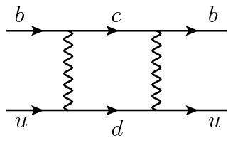
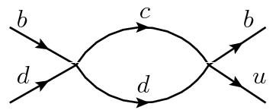
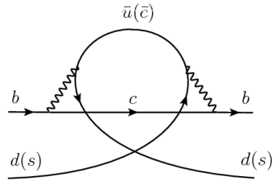
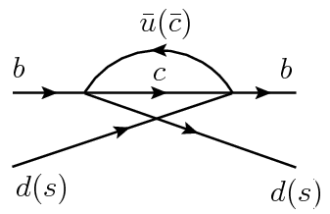
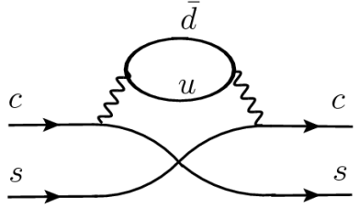
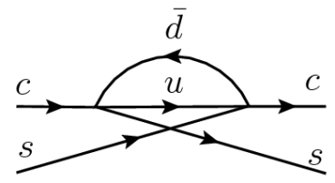
Optical theorem
Under OPE
Spectator effects described by dim-6 four-quark operators:
W-exchange
destructive P.I.
(Pauli interference)
constructive P.I.
(only for charmed baryons)

Slide 5
Examples of dim-6 four-quark operators for spectator effects
How to evaluate hadronic matrix elements?
Meson matrix elements: bag parameters guided by vacuum insertion approx. (VIA)
VIA ⇒ B_{i} = 1, ε_{i}= 0
estimated using QCD sum rules, LQCD,..., and updated recently by Kirk, Lenz, Rauch using HQET sum rules (’17)

Slide 6
Baryon matrix elements: quark model
: antitriplet baryon T_{b} or sextet baryon Ω_{b}
r is a wave function ratio
∼
B defined by
∼
B=1 in valence-quark approx, valid at hadronic scale

Slide 7
Lifetimes of bottom mesons
Inclusive semileptonic rate of B→ X_{c}e⁺ν_{e} is very sensitive to m_{b}.
Two short-distance b-quark masses: kinetic & 1S schemes.
A global fit to B→ X_{c}e⁺ν_{e} yields m_{b}^{kin}(1 GeV) = 4.546 ± 0.021 GeV
Gambino, Healey, Turczyk (’16)
Using the bag parameters obtained by Kirk, Lenz, Rauh as input
 | Dec | Ann | Int(-) | Semi | τ (10⁻¹²s) | Expt (10⁻¹²s)
B⁺ | 1 |  | 1 | 1 | 1.717 | 1.638±0.004
B_{d}⁰ | 1 | 1 |  | 1 | 1.589 | 1.520±0.004
B_{s}⁰ | 1 | 1 |  | 1 | 1.583 | 1.510±0.005
in excellent with experiment!

Slide 8
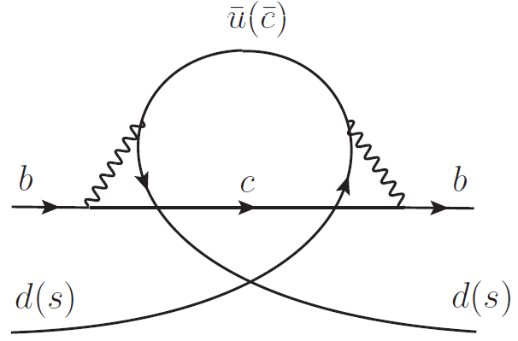
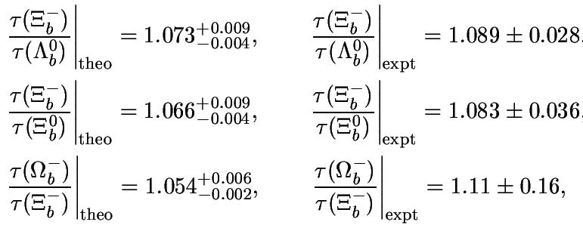
Lifetimes of singly bottom baryons
 | Dec | Ann | Int (-) | Semi | τ (10⁻¹²s) | Expt (10⁻¹²s)
Λ_{b}⁰ | 1 | 1 | 1 | 1 | 1.520 | 1.470±0.009
Ξ_{b}⁰ | 1 | 1 | 1 | 1 | 1.529 | 1.479±0.030
Ξ_{b}⁻ | 1 |  | 2 | 1 | 1.630 | 1.571±0.030
Ω_{b}⁻ | 1 |  | 10/3 | 1 | 1.725 | 1.64^{+0.18}_{-0.17}
HYC (’18)
Lifetime hierarchy τ(Ω_{b}⁻) > τ(Ξ_{b}⁻) > τ(Ξ_{b}⁰) ~ τ(Λ_{b}⁰)
Heavy quark expansion (HQE) in 1/m_{b} works very well for B mesons and bottom baryons!
8

Slide 9
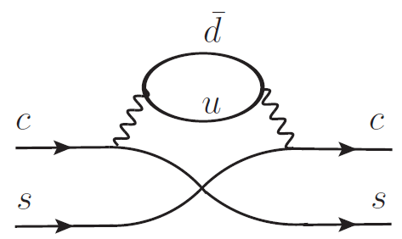
 | Dec | Ann | Int (-) | Int (+) | Semi | τ (10⁻¹³s) | Expt (10⁻¹³s)
Ξ_{c}⁺ | 1 | s² | 1 | c² | small P.I. | 3.06 | 4.42±0.26
Λ_{c}⁺ | 1 | c² | 1 | s² | no P.I. | 2.91 | 2.00±0.06
Ξ_{c}⁰ | 1 | 1 | 0 | c² | small P.I. | 1.62 | 1.12^{+0.13}_{-0.10}
Ω_{c}⁰ | 1 | 6s² |  | 10/3 c² | large P.I. | 1.06 | 0.69±0.12
s=sinθ_{C}, c=cosθ_{C}
additional constructive
P.I. contribution to Γ^{semi}
Voloshin (’96)
Current lifetime hierarchy τ(Ξ_{c}⁺) > τ(Λ_{c}⁺) > τ(Ξ_{c}⁰) > τ(Ω_{c}⁰) is
understandable qualitatively, but not quantitatively.
It is difficult to explain τ(Ξ_{c}⁺)/τ(Λ_{c}⁺) = 2.21±0.15
1/m_{c} expansion not well convergent and sensible
9

Slide 10
A₄: dim-7 operators
Consider subleading 1/m_{c} corrections to spectator effects:
Beneke, Buchalla, Dunietz (’96): width difference in B_{s}-B_{s} system
Gabbiani, Onishchenko, Petrov (’03,’04): lifetime difference of heavy hadrons
Lenz, Rauh (’13): D meson lifetimes
obtained by expanding forward scattering amplitude in light quark momentum and matching the result onto operators containing derivative insertions
Gabbiani, Onishchenko, Petrov (’03,’04)
Dim-7 4-quark operator is either 4-quark operator times m_{q} or
4-quark operator with an additional or two derivatives
10

Slide 11
to 1/m_{c}³
with 1/m_{c} corrections to spectator effects
Γ(Λ_{c}⁺) enhanced, Γ(Ξ_{c}⁺) suppressed
⇒ τ(Ξ_{c}⁺)/τ(Λ_{c}⁺) is increased from 1.05 to 1.88
Shortest-lived Ω_{c} becomes longest-lived one after 1/m_{c}
corrections !!!

Slide 12
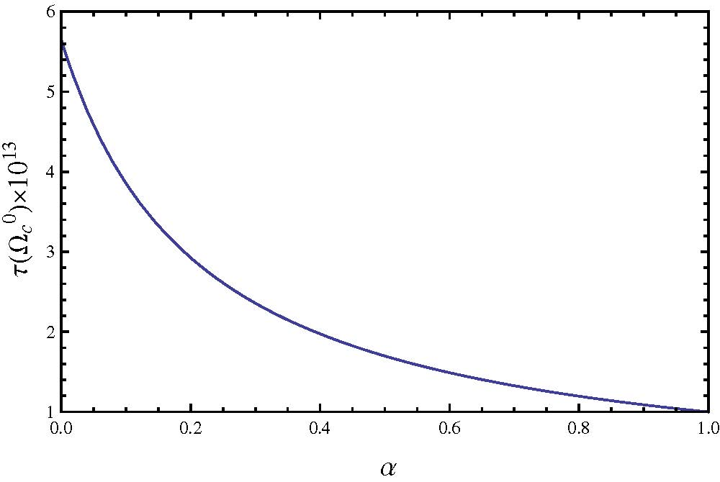
Γ₊^{int} = Γ₆^{int} + Γ₇^{int}, Γ^{semi} = Γ₆^{semi} + Γ₇^{semi}
Destructive contributions from Γ₇^{int} & Γ₇^{semi} are too large to justify the validity of HQE
Introduce a parameter α to describe the degree of suppression for Γ₇^{int} & Γ₇^{semi}
Guideline for α: positive Γ₊^{int} & Γ^{semi} with results close to that of Ξ_{c}

Slide 13
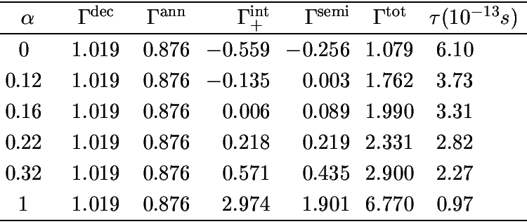
$$0.16<α<0.32$$
We conjecture that
2.3$×{10}^{−13}s<τ\left(Ω_{c}^{0}\right)<3.3×{10}^{−13}s$
τ(Ξ_{c}⁺) > τ(Ω_{c}⁰) > τ(Λ_{c}⁺) > τ(Ξ_{c}⁰)

Slide 14
Talk presented at HIEPA 2018 Workshop (March 19-21, 2018, Beijing)
τ(Ω_{c}⁰) = 2.31×10⁻¹³s for α=0.25

Slide 15
LHCb 1807.02024
τ(Ω_{c}⁰) = (2.68±0.24±0.10±0.02)×10⁻¹³s
Four-times larger than the world average of (0.69± 0.12)×10⁻¹³s from fixed target experiments!
events
64
86
25
~ 1000 events

Slide 16
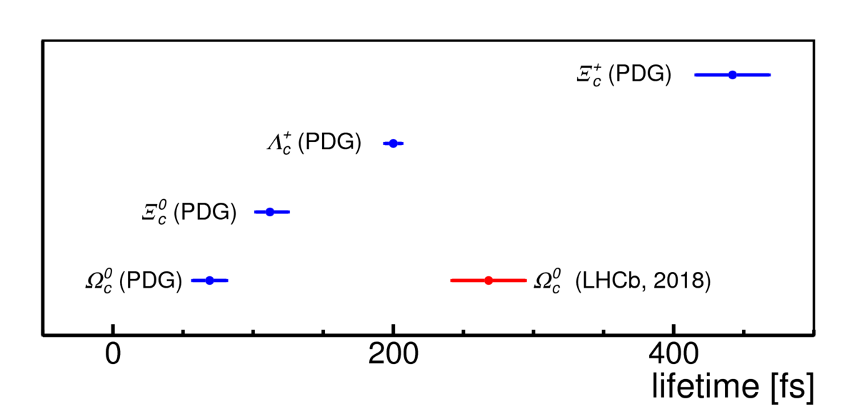
τ(Ξ_{c}⁺) > τ(Ω_{c}⁰) > τ(Λ_{c}⁺) > τ(Ξ_{c}⁰)

Slide 17
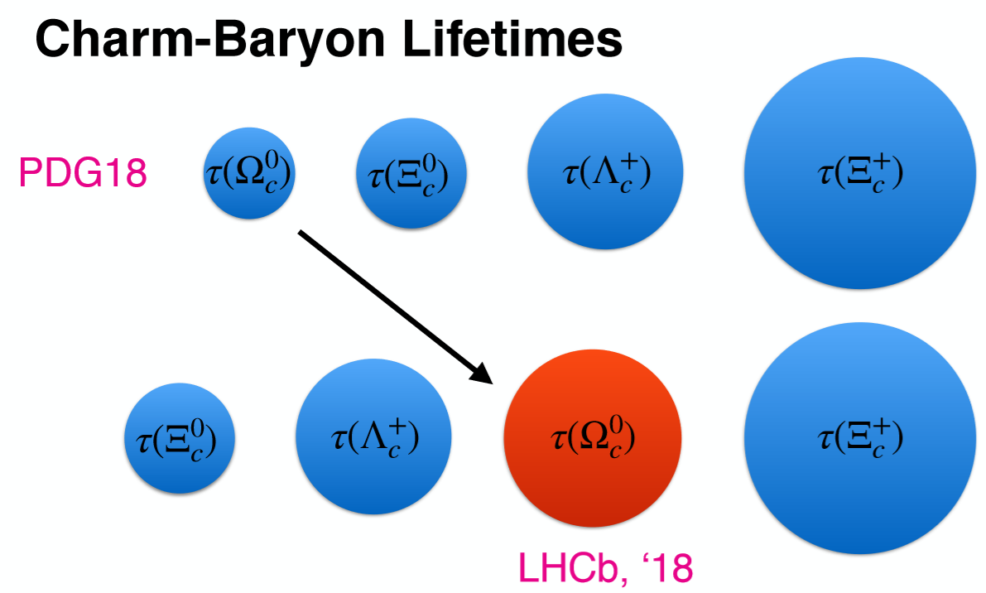

Slide 18
Lifetimes of doubly charmed baryons
with Yan-Liang Shi

Slide 19
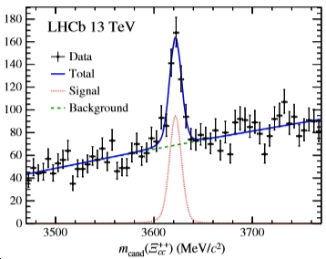
Doubly charmed baryon discovered by LHCb (’17)
Yu, Jiang, Li, Lu, Wang, Zhao [1703.09086]
M = 3621.40 ± 0.72 ± 0.27 ± 0.14 MeV
longstanding expt’l puzzle

Slide 20
Lifetimes of doubly charmed baryons
in units of τ(10⁻¹³ s)
 | Kiselev et al (’98) | Kiselev et al (’99) | Guberina et al (’99) | Chang et al (’08) | Karliner, Rosner (’14)
Ξ_{cc}⁺⁺ | 4.3±1.1 | 4.6±0.5 | 15.5 | 6.7 | 1.85
Ξ_{cc}⁺ | 1.1±0.3 | 1.6±0.5 | 2.2 | 2.5 | 0.53
Ω_{cc}⁺ |  | 2.7±0.6 | 2.5 | 2.1
Large theoretical uncertainties
τ(Ξ_{cc}⁺⁺) > τ(Ω_{cc}⁺) ~ τ(Ξ_{cc}⁺)

Slide 21
Lifetimes of doubly charmed baryons
 | Dec | Ann | Int(-) | Int(+) | Semi | τ(10⁻¹³ s)
Ξ_{cc}⁺⁺ | 1 |  | 1 |  | 1 | 1.9~15.5
Ξ_{cc}⁺ | 1 | 1 |  | s² | 1 + s² P.I. | 0.5~ 2.5
Ω_{cc}⁺ | 1 | s² |  | 1 | 1 + c² P.I. | 2.1~ 2.8
Ξ_{cc}⁺⁺
Ξ_{cc}⁺
Ω_{cc}⁺
τ(Ξ_{cc}⁺⁺) > τ(Ω_{cc}⁺) ~ τ(Ξ_{cc}⁺)

Slide 22
Dim-3 and -5 operators
$σ⋅G∝{\vec{S}}_{c}⋅{\vec{S}}_{q}$ for singly heavy baryon
$∝{\vec{S}}_{d}⋅{\vec{S}}_{q},$ ${\vec{S}}_{1}⋅{\vec{S}}_{2}$ for doubly heavy baryon
${\vec{S}}_{d}={\vec{S}}_{1}+{\vec{S}}_{2}$: spin of the diquark

Slide 23
HQET is not the appropriate EFT for hadrons with more than one heavy quark as $T_{Q}$ is important and cannot be treated as a small perturbation ⇒ HQET replaced by NRQCD (or pNRQCD)
Darwin term is of same order as chromomagetic field
while Kiselev, Likhoded, Onischenko (’98) obtained

Slide 24
to 1/m_{c}³
$$Γ^{ann}≫Γ_{+}^{int}$$
⇒ τ(Ξ_{cc}⁺⁺) > τ(Ω_{cc}⁺) > τ(Ξ_{cc}⁺)
$$Γ^{semi}\left(Ω_{cc}^{+}\right)≫Γ^{semi}\left(Ξ_{cc}^{+}\right)>Γ^{semi}(Ξ_{cc}^{++})$$
After including 1/m_{c} corrections to spectator effects
τ(Ξ_{cc}⁺⁺) becomes shorter, while τ(Ω_{cc}⁺) becomes longer
The use of HQE for Γ^{int}₊ & Γ^{semi} for Ω_{cc} is not valid
24

Slide 25
Needs to suppress Γ₇^{int} & Γ₇^{semi} to make the use of HQE sensible!
τ(Ξ_{cc}⁺⁺) > τ(Ω_{cc}⁺) > τ(Ξ_{cc}⁺)
with τ(Ξ_{cc}⁺⁺) ~ 3.0×10⁻¹³s & τ(Ξ_{cc}⁺) ~ 0.45×10⁻¹³s
$0.75×{10}^{−13}s<τ\left(Ω_{cc}^{+}\right)<1.80×{10}^{−13}s$
LHCb: τ(Ξ_{cc}⁺⁺) = (2.56^{+0.24}_{-0.22}±0.14)×10⁻¹³ s
1806.02744
$$\frac{τ\left(Ξ_{cc}^{++}\right)}{τ\left(Ξ_{cc}^{+}\right)}∼6.7$$

Slide 26
Conclusions
HQE in 1/m_{b} works well for the lifetimes of B mesons and bottom
baryons.
HQE in 1/m_{c} fails to provide a satisfactory description of the lifetimes
of D mesons & charmed baryons to O(1/m_{c}³). Need to consider
subleading 1/m_{c} corrections to spectator effects.
Dim-7 operators are in the right direction to enhance Γ(Λ_{c}⁺) &
suppress Γ(Ξ_{c}⁺), but they will render the lifetime of Ω_{c}⁰ longer than Λ_{c}⁰
For doubly charmed baryons, we found τ(Ξ_{cc}⁺⁺) > τ(Ω_{cc}⁺) > τ(Ξ_{cc}⁺) with
τ(Ξ_{cc}⁺⁺) ∼ 0.30 ps, τ(Ξ_{cc}⁺) ∼ 0.05 ps,

