Slide 1

Optimising inflationary features – the Bayesian way
Jan Hamann
based on arXiv:2110.XXXXX
with
Julius Wons
International Joint Workshop on the SM and Beyond
NTHU, 14th-15th October 2021

Slide 2
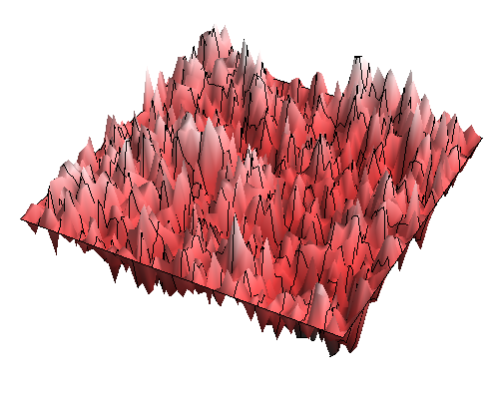
Inflation
field perturbation
𝛿ϕ
curvature perturbation
𝛿R
Inflaton potential V(ϕ)
Inflaton field ϕ

Slide 3
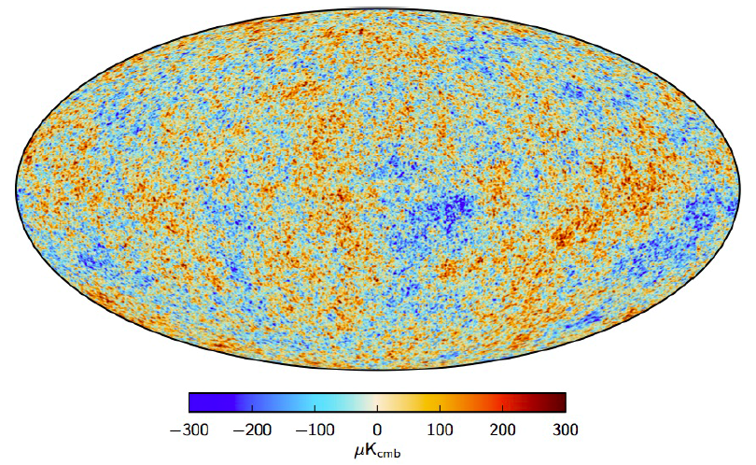
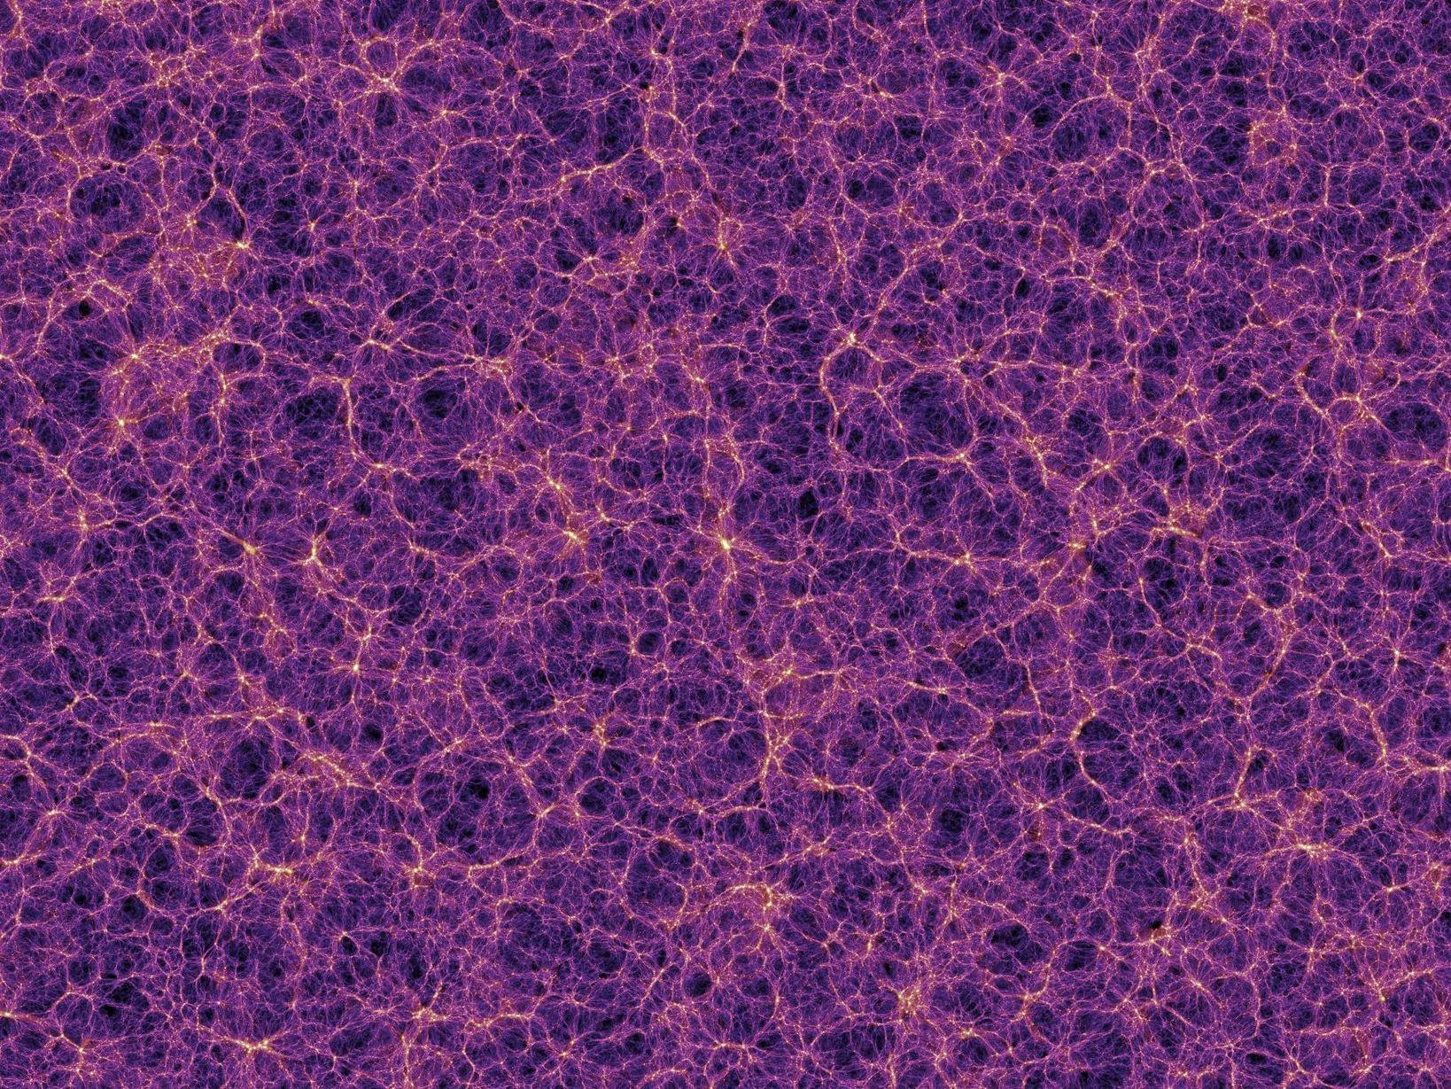
Initial conditions for structure formation
curvature perturbation
𝛿R
CMB
Large Scale
Structure

Slide 4
Standard inflation: smooth power spectrum
primordial power spectrum
curvature perturbation
𝛿R

Slide 5
Standard inflation: smooth power spectrum
primordial power spectrum
  Assumptions
Slow-roll attractor reached
Smooth inflaton potential
Bunch-Davies vacuum
Other fields can be integrated out

Slide 6
Inflation with features
  Assumptions
Slow-roll attractor reached
Smooth inflaton potential
Bunch-Davies vacuum
Other fields can be integrated out
break any of these
Features!
generically: oscillations in k or ln k
[Chluba, JH, Patil 2015]

Slide 7
Features models: examples
Linear oscillation model
(effects periodic in conformal time)
ordinary power law
modulation
Logarithmic oscillation model
(effects periodic in cosmic time)

Slide 8
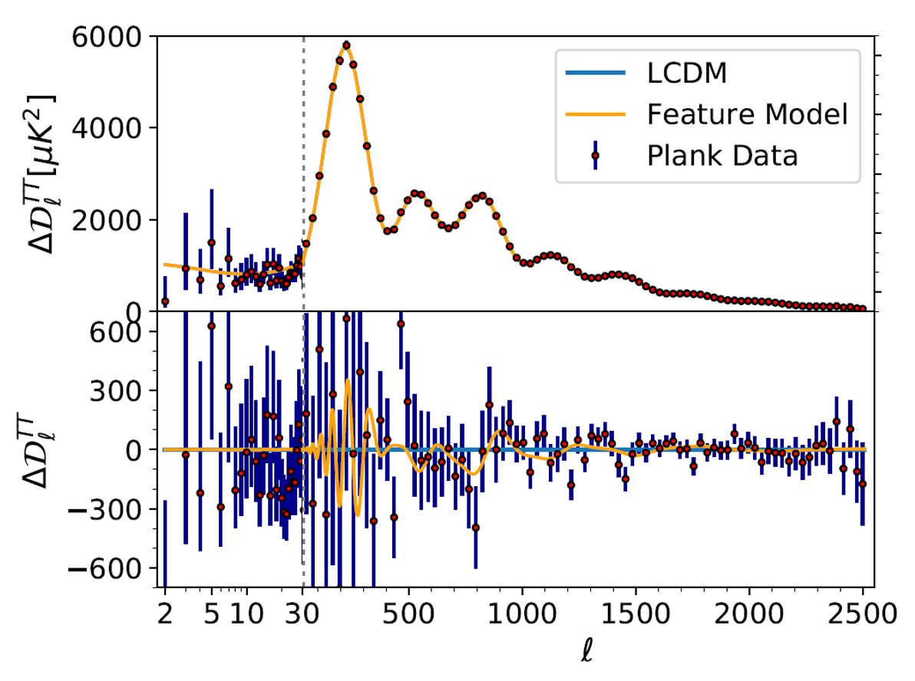
Fit to CMB data
CMB temperature
angular power spectrum
Planck data
residuals with respect to
LCDM best fit

Slide 9
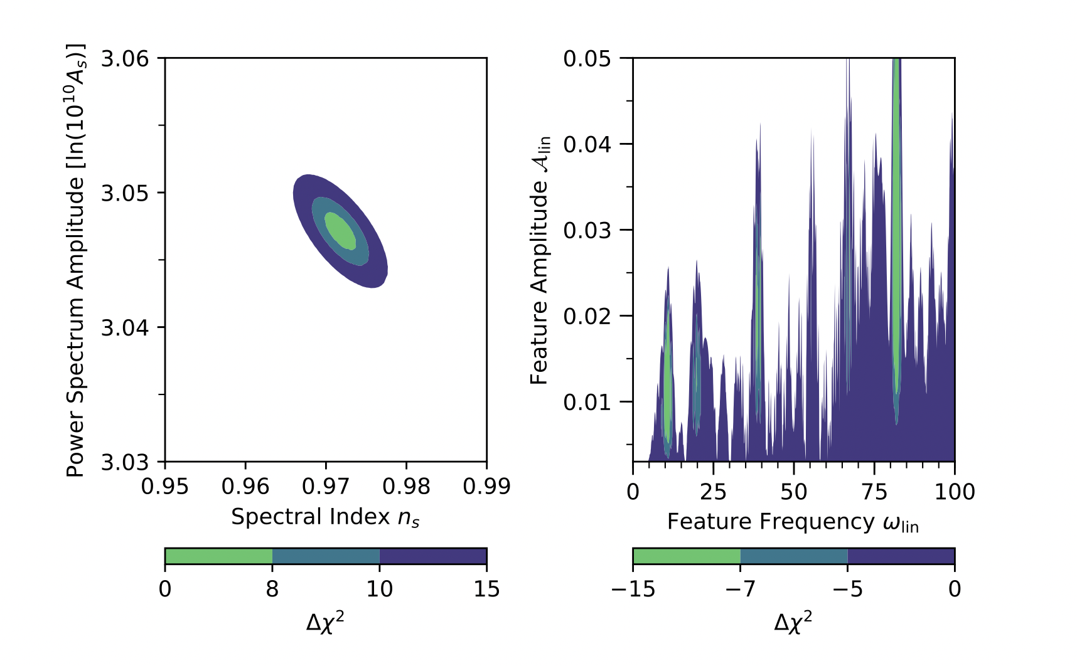
Complications…
Complex structure of likelihood function
Increased requirements for numerical accuracy
  Computation of CMB spectra
  Likelihood evaluation
Takes O(1 min) to calculate likelihood for one single combination of parameters
Commonly used Markov chain Monte Carlo methods are very inefficient here

Slide 10
Bayesian optimisation
Step 1: Regression
Guess the shape of the function based on known function values (``data’’)
Step 2: Selection
Decide at which point to evaluate the next function value
Goal: find global maximum of function
(and learn general shape in the process)

Slide 11
Bayesian optimisation
Step 1: Regression
Guess the shape of the function based on known function values (``data’’)
Step 2: Selection
Decide at which point to evaluate the next function value
Gaussian
Process
Regression
Acquisition function:
Expected Improvement
Goal: find global maximum of function
(and learn general shape in the process)

Slide 12
Gaussian Process Regression (GPR)
Data: (x_{i},y_{i}) Covariance of the data: Σ_{ij}

Slide 13
Gaussian Process Regression (GPR)
?
Data: (x_{i},y_{i})

Slide 14
Gaussian Process
draw a sample from
Imagine for each x, f(x) is a random Gaussian variate drawn from
mean
variance

Slide 15
Gaussian Process
Gaussian process is specified by
Example covariance function:
covariance function
hyperparameters
prior width
correlation length
y
y
larger/smaller
A and L
x
x

Slide 16
Gaussian Process Regression (GPR)
Take function space generated by Gaussian process GP as prior probability distribution for f
Consider data (x_{i},y_{i}) as condition
GP|(x_{i},y_{i}) is the posterior probability distribution for f (this is still an infinite space of functions, but one can now evaluate, e.g., expectation value and covariance)

Slide 17
Gaussian Process Regression
Data: (x_{i},y_{i})
Covariance of the data: Σ_{ij}
Covariance function: K(x,x’)
Test values: x_{i}*
Input
hyperparameters: h
straightforward
linear algebra
Target means: f(x_{i}*)
Covariance of the targets: Σ_{ij}*
Marginal likelihood: E(h,y|x)
Output
probability of the model given the data

Slide 18
Gaussian Process Regression
Data: (x_{i},y_{i})
Covariance of the data: Σ_{ij}
Covariance function: K(x,x’)
Test values: x_{i}*
Maximise marginal likelihood as function of hyperparameters
=
Let the data decide on the most appropriate Gaussian process!
Input
hyperparameters: h
straightforward
linear algebra
Target means: f(x_{i}*)
Covariance of the targets: Σ_{ij}*
Marginal likelihood: E(h,y|x)
Output
probability of the model given the data

Slide 19
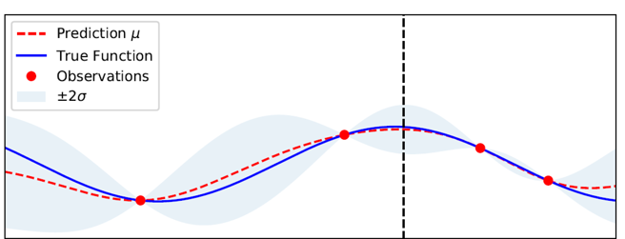
Gaussian Process Regression

Slide 20
Where to draw the next sample?
Exploration?
Exploitation?

Slide 21
Where to draw the next sample?
Define an acquisition function dependent on GPR mean and uncertainty
Pick value that maximises acquisition function
Acquisition function:
Expected Improvement
Exploration?
Exploitation?

Slide 22
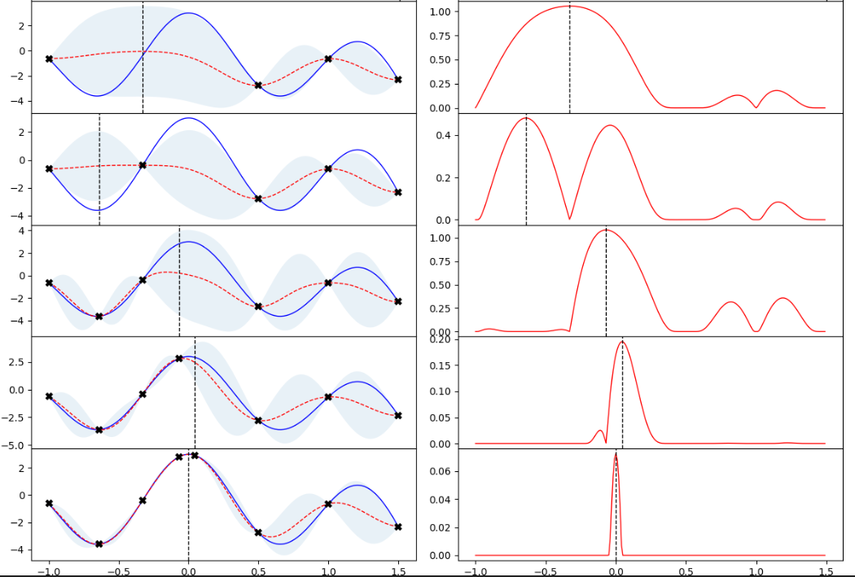
Bayesian optimisation
Gaussian Process Regression
Expected improvement
iteration #
data
GPR mean
uncertainty
1
true function

Slide 23
Bayesian optimisation
Gaussian Process Regression
Expected improvement
iteration #
data
GPR mean
uncertainty
1
true function
2

Slide 24
Bayesian optimisation
Gaussian Process Regression
Expected improvement
iteration #
data
GPR mean
uncertainty
1
true function
2
3

Slide 25
Bayesian optimisation
Gaussian Process Regression
Expected improvement
iteration #
data
GPR mean
uncertainty
1
true function
2
3
4

Slide 26
Bayesian optimisation
Gaussian Process Regression
Expected improvement
iteration #
data
GPR mean
uncertainty
1
true function
2
3
4
5

Slide 27
Pros and cons of Bayesian Optimisation
+ high efficiency
+ excellent at finding global maximum of complicated functions
+ very good at determining overall shape, profiles of function
o currently no evaluation of marginalized posterior or Bayesian evidence (can in principle be done though!)
- scales very unfavourably with number of dimensions (realistically it won’t work well for more than 5-6 dimensions)

Slide 28
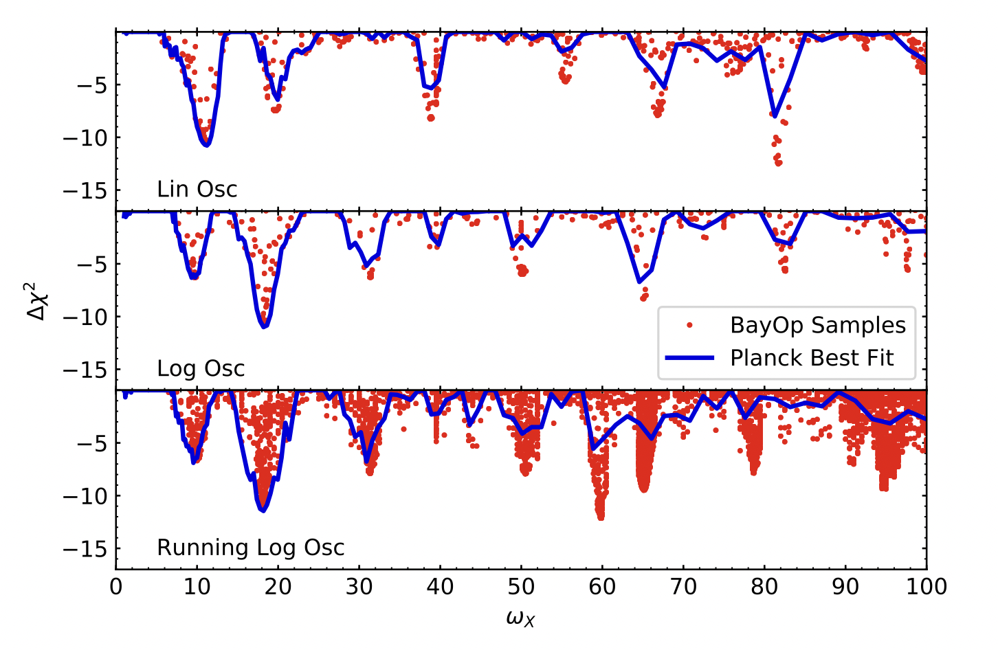
Bayesian optimization with feature models
[Planck inflation 2018]
using nested sampling
red dots: our results
Two orders of magnitude fewer function evaluations
Much better at finding global and local extrema

Slide 29
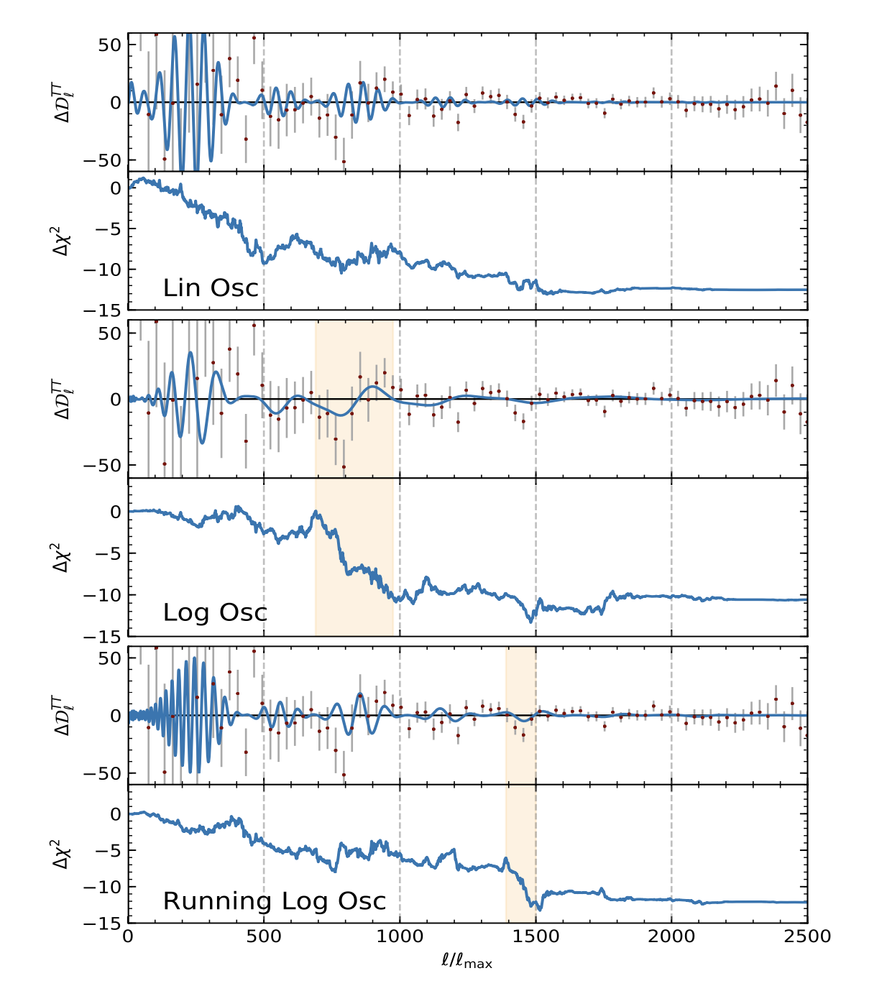
Feature best-fits vs. Planck residuals

Slide 30
Evidence for features?
Simulations of featureless Planck-like data
Linear oscillation model
Logarithmic oscillation model
It would require 𝛥χ² > 20 to claim a detection
[Planck inflation 2015]

Slide 31
Conclusions
Inflationary features: unique signatures of new physics
Bayesian optimisation is a very efficient machine-learning technique for extremising unknown functions
It can also be applied to cosmological parameter estimation
We’ve improved on previous MCMC-based results for inflationary feature searches
Paper and code out soon!

