Slide 1

Collider Physics (I)
Chuan-Ren Chen
NTNU
NCTS HEP Summer Program, 6/29/2022

Slide 2

Standard Model
Particle Productions and Decays
Colliders
Some Kinematics
Simulations

Slide 3
Natural Units
光速
length 長度 <-> time 時間
energy 能量 <-> 1/length 1/尺度
energy, mass : GeV
1 eV (electron volt) = (1.6x10⁻¹⁹ C) x (1 V) = 1.6x10⁻¹⁹ joules
G (Giga) -> 10⁹
T (Tera) -> 10¹²
p (pico) -> 10⁻¹²
f (fento) -> 10⁻¹⁵

Slide 4
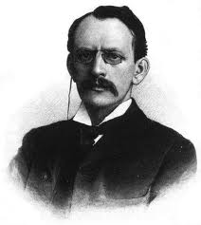

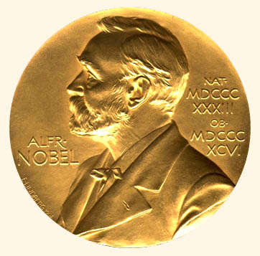
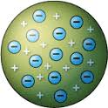
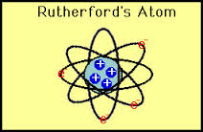
Fundamental Particles
discovery of electron (e⁻)
1897
“plum pudding model” of atom
1906
J. J. Thomson
proton
neutron
discovery of muon (μ⁻), 1936, by C. D. Anderson and S. Neddermeyer

Slide 5
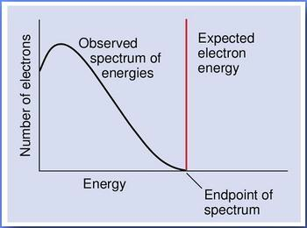
neutrino
beta decay: changes both Z and N by one unit,
, , so that A = Z+N = const.
e.g. ²³Ne(Z=10,N =13) -> ²³ Na(Z=11,N=12)
visible particle: electron
n -> p + e⁻

Slide 6
neutrino
Pauli: beta decay: n -> p + e⁻ + neutrino (1930)
the discovery of electron neutrino ( ) : 1959, by Cowan & Reines (Nobel prize, 1995)
the discovery of muon neutrino ( ): 1962, by Lederman, Schwartz and Steinberger
(Nobel prize 1988)
So now, we have:

Slide 7

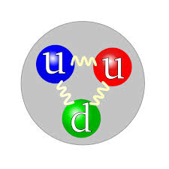
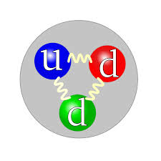

Many new particles were found in 50’s, e.g.
are they all fundamental?
Gell-Mann (Nobel prize 1969) & Zweig (1964):
quark model: u, d, s
these hadrons are made of u, d, s quarks!
deep inelastic electron-nucleon scattering exp. @ SLAC in 60’s supported quark model

Slide 8
1974, discovery of charm quark (c-quark) independently, simultaneously, by two groups,
Burton Richter et al. (SLAC)、
Samuel Ting（丁肇中） et al. (BNL), Nobel prize 1976
(November revolution in particle physics!!)
now,

Slide 9
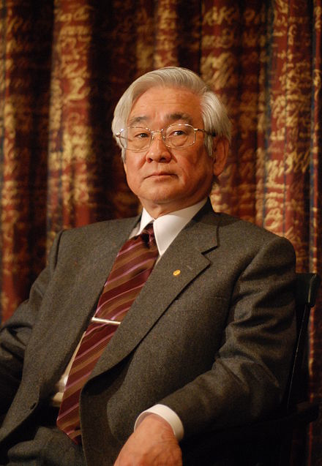
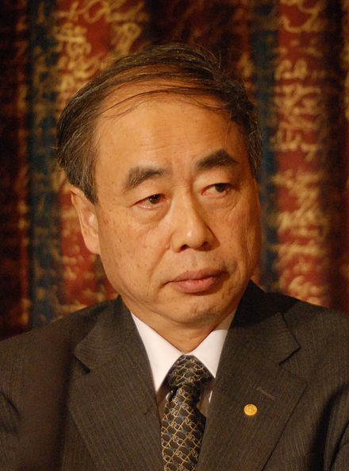
Toshihide Maskawa
Makoto Kobayashi
2008 Nobel prize
1973, proposed the existence of third generation quark: top & bottom
discovery of bottom quark (b), 1977 Leon Lederman et al. (FNAL)
discovery of top quark (t), 1995 D0 & CDF collaborations (FNAL)
discovery of tauon ( ), 1975, by M. Perl (Nobel prize 1995)
discovery of tauon neutrino ( ), 2000, by DONUT collaboration (FNAL)
Notes:
理論：好像很厲害，不喜歡作實驗，喜歡自由。科普書（柏拉圖的天空），物理老師

Slide 10

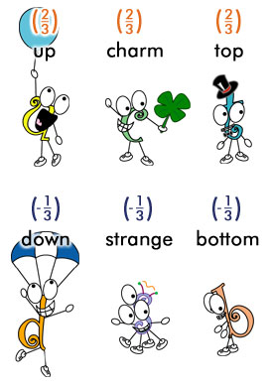
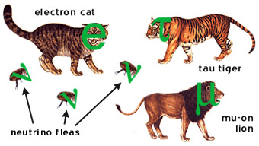
What we know now
6 quarks
6 leptons
3 generations
3 generations

Slide 11

Force Carrier
all interactions which affect matter particles are due to an exchange of force carrier particles. "forces" are actually the effects of force carrier particles on matter particles
http://www.particleadventure.org/unseen.html

Slide 12
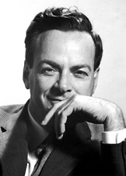
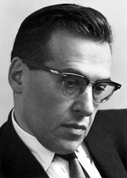
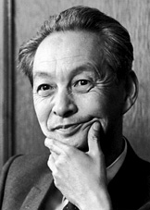
Electromagnetic
Richard Feynman
Julian Schwinger
Sin-Itrio Tomonaga
Nobel prize 1965
Quantum Electrodynamics (QED)
“ for their fundamental work in quantum electrodynamics, with deep-ploughing consequences for the physics of elementary particles.”
Notes:
理論：好像很厲害，不喜歡作實驗，喜歡自由。科普書（柏拉圖的天空），物理老師

Slide 13
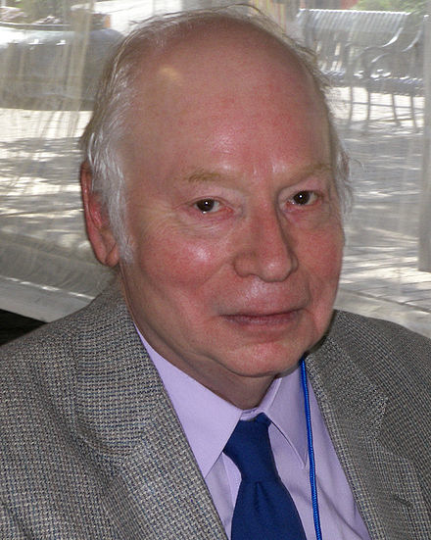
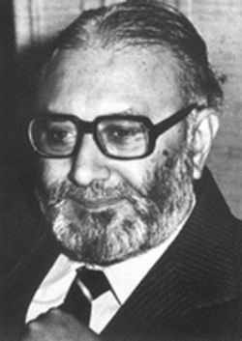
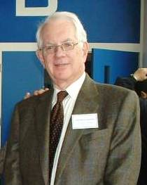
Weak
Steven Weinberg
Abdus Salam
Sheldon Glashow
Nobel prize 1979
1960’s Electroweak Theory
prediction of W and Z bosons
discovered in 1983 at CERN
Notes:
理論：好像很厲害，不喜歡作實驗，喜歡自由。科普書（柏拉圖的天空），物理老師

Slide 14
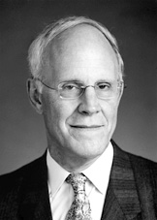
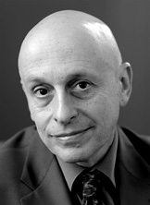
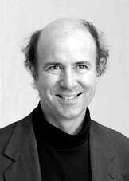
Strong
1960’s, 1970’s, development of Quantum Chromodynamics
prediction of gluon bosons
discovered in 1979 at DESY
David Gross
H. David Politzer
Frank Wilczek
Nobel prize 2004
“for the discovery of asymptotic freedom of the theory of the strong interaction”
Notes:
理論：好像很厲害，不喜歡作實驗，喜歡自由。科普書（柏拉圖的天空），物理老師

Slide 15
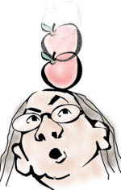

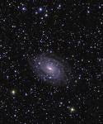

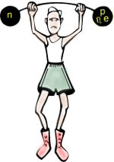

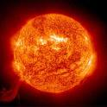
What we know
four interactions
gravity
electromagnetism
weak
strong

Slide 16
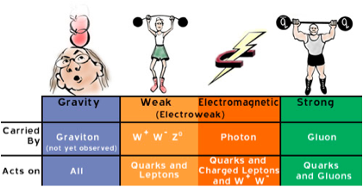
What we know
four interactions
gravity
electromagnetism
 | Gravity | Weak | Electromagnetic | Strong
Carried by | Graviton (not yet observed) | W⁺ W⁻ Z | Photon | Gluon
Acts on | All | Quarks and Leptons | Quarks, Charged Leptons and W⁺ W⁻ | Quarks and Gluons
(ElectroWeak)
(massive)
(massless)
weak
strong

Slide 17
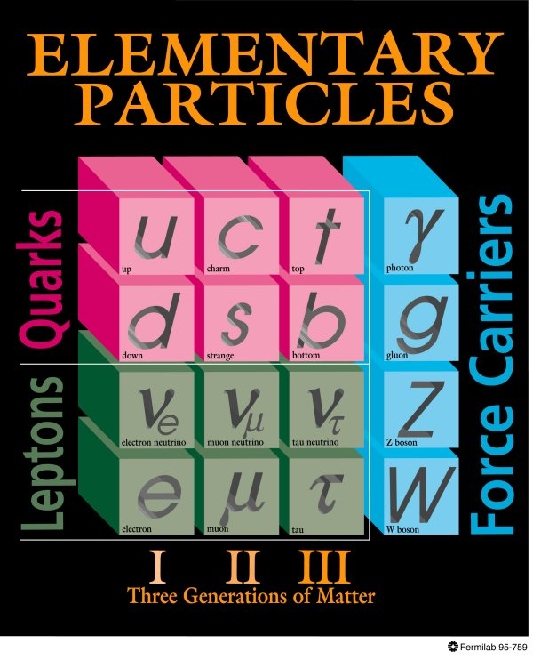
Standard Model

Slide 18
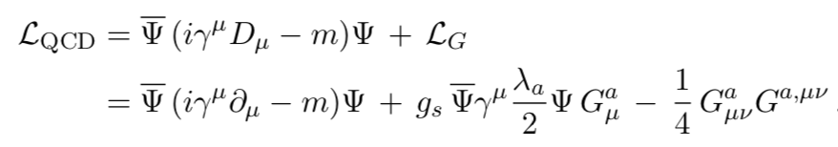



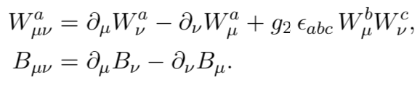
more about Standard Model
Standard Model
a gauge theory: SU(3)_{c}xSU(2)_{L}xU(1)_{Y}
strong
electroweak
Lagrangian:
L_{SM} = L_{QCD} + L_{EW}
gluon

Slide 19
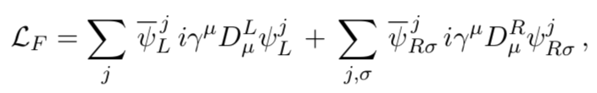
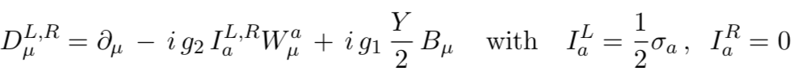



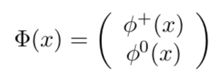
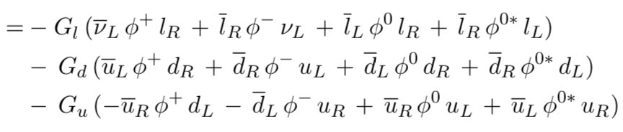

Slide 20

Standard Model
every particle is massless under electroweak symmetry, i.e. mass term is not allowed.
electroweak symmetry must be broken!
BUT, how?
Spontaneous breaking -> Higgs mechanism
In Standard Model, a Higgs boson is predicted.

Slide 21
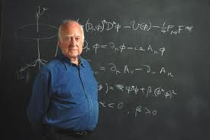
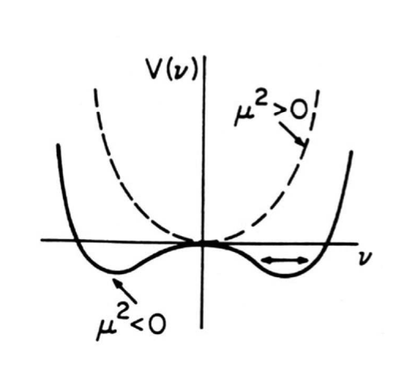
Electroweak Spontaneous Symmetry Breaking in Standard Model –
Higgs Mechanism
V min locates at
for μ² < 0: minima -> symmetry is not broken
for μ² > 0: minima -> breaking symmetry

Slide 22
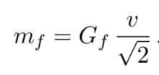

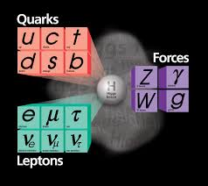

mass:

Slide 23
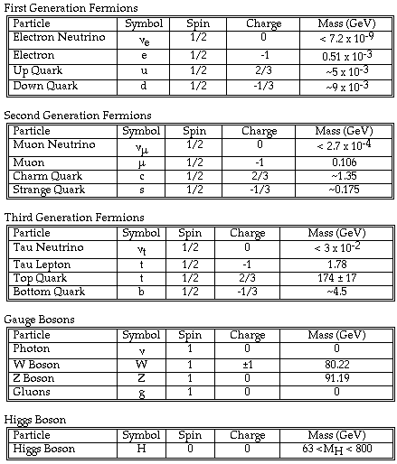
found in 2012! 125 GeV

Slide 24
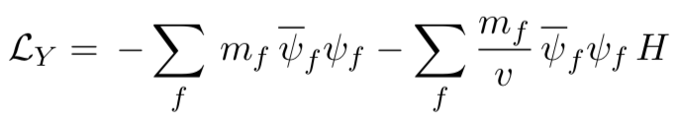

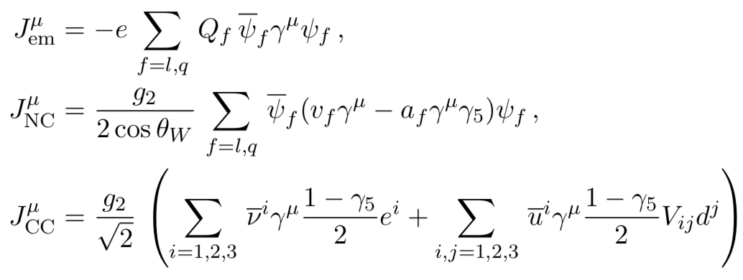
Interaction
…

Slide 25
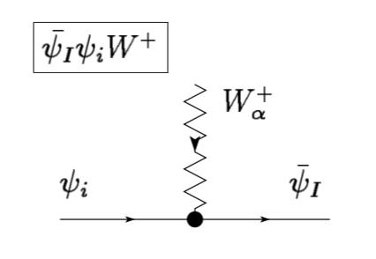
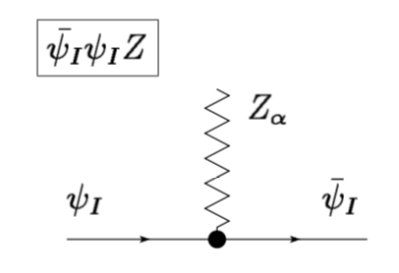
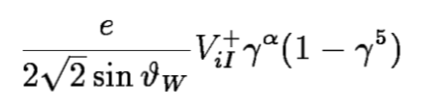
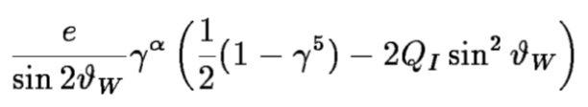
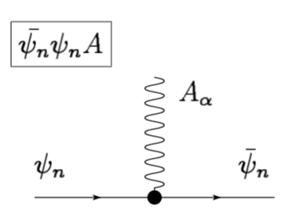
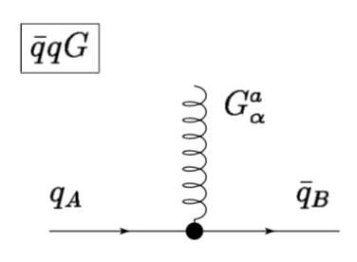


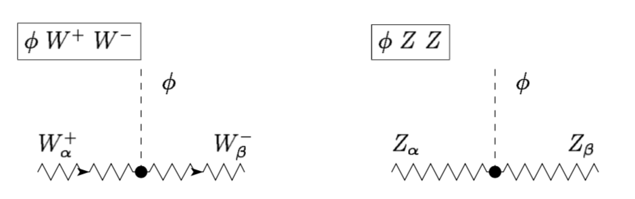
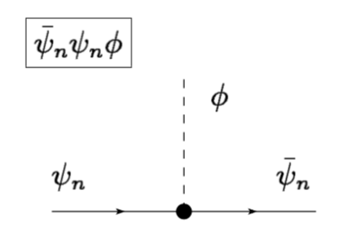
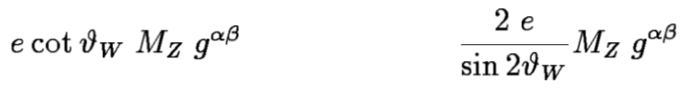


Slide 26
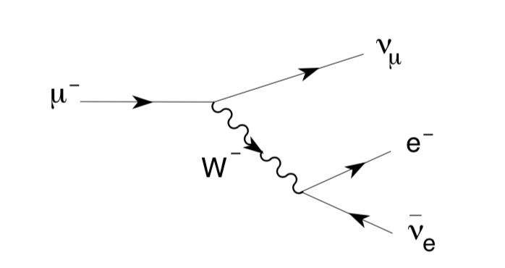

Slide 27
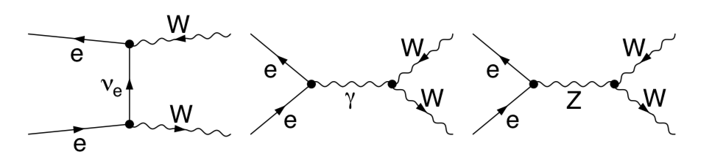


Testing SM

Slide 28
Testing SM

Slide 29


Testing SM
(April, 2021)

Slide 30

speed of star
distance from the center
Dark Matter?

Slide 31


Massive neutrinos

Slide 32
Backup

Slide 33


