Slide 1
A Study on
Loop-Induced Neutrino Masses
Da Huang
Physics Department, NTHU
@ NTU
JHEP 1508 (2015) 141 [arXiv: 1507.03455] &
Eur.Phys.J. C75 (2015) 11, 557 [arXiv: 1508.02180]
In Collaboration with C.-Q. Geng, L.-H. Tsai and Q. Wang

Slide 2
Content
Introduction of Neutrino Masses and Mixings
Possible Origins of Neutrino masses
Effective Field Theory Perspective
A Model with dark matter
Final Results and Summary

Slide 3
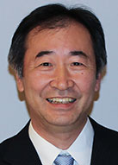
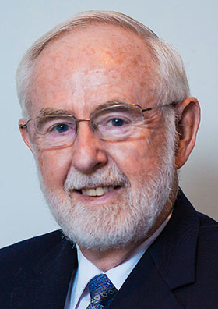
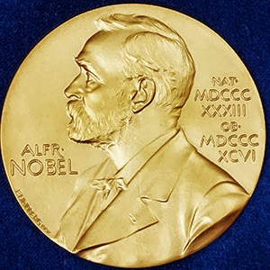
Introduction
Neutrino oscillation experiments with solar, atmospheric, reactor and accelerator neutrinos clearly showed that neutrinos have tiny but non-zero masses.
The Nobel Prize in Physics 2015 was awarded jointly to Takaaki Kajita and Arthur B. McDonald "for the discovery of neutrino oscillations, which shows that neutrinos have mass"
Takaaki Kajita
Arthur B. McDonald

Slide 4
Introduction
However, in the minimal Standard Model (SM) without right-handed neutrinos, the neutrino masses are predicted to be exactly zero.
Thus, the origin of neutrino masses must be related to the new physics beyond the SM.

Slide 5
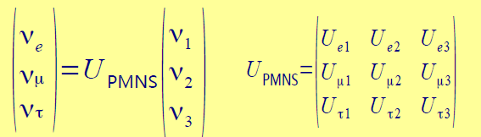
Introduction
If the neutrinos have masses, different flavors would generically mix with each other due to the mismatch of the flavor and mass eigenstates.
In the charged lepton mass basis, the neutrino mixings are

Slide 6

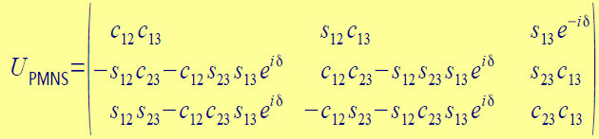
Introduction
Currently, it is still unknown if neutrinos are Dirac particles or Majorana ones
Dirac Neutrinos: Lepton number conserved
U_{PMNS}: 3 rotation angles + 1 Dirac phase
Standard Parametrization in charged lepton mass eigenbasis

Slide 7
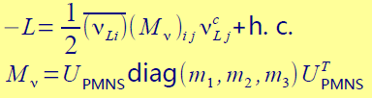
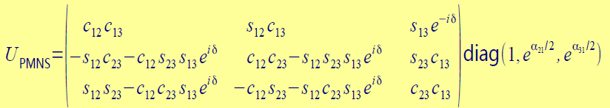
Introduction
Majorana Neutrinos: Lepton number U(1) symmetry broken
U_{PMNS}: 3 rotation angles + 1 Dirac phase + 2 Majorana phases
Standard Parametrization in charged lepton mass eigenbasis

Slide 8




Introduction
Mixing Angle
What Neutrino Oscillation tell us:
Solar Neutrino: Homestake, GALLEX, SNO, SK, KamLAND
Δm₂₁², sin²θ₁₂
Atmospheric Neutrino: Super-K
|Δm₃₂²|, sin²θ₂₃
Reactor Neutrino: Double Chooz, Daya Bay, RENO
sin²θ₁₃
Accelerator Neutrino: K2K, MINOS, LSND, MiniBooNE, OPERA

Slide 9
Introduction
Neutrino Mass: what we know PDG(2014)
Normal hierarchy: m₁<m₂<<m₃
Inverted hierarchy: m₃<<m₁<m₂

Slide 10
Introduction
Neutrino Mass: what we do NOT know
Origin of the tiny but non-zero neutrino masses
Neutrinos: Majorana or Dirac particles?
Mass hierarchy: Normal or Inverted?
Absolute value of neutrino masses?
Tritium decay exp. : (m_{ν})_{e} < 2.05 eV Troitsk
CMB: Σ_{i} (m_{ν})_{i} < 0.66 eV Planck
Values of the 3 CP violating phases: δ, α₂₁, α₃₁

Slide 11
Possible Origin: Dirac Neutrinos
Dirac Neutrino Masses:
Right-handed Neutrinos: (N_{R})_{a} , a=1,2,3
Yukawa couplings:
EW broken
with
A Hierarchy Problem:

Slide 12
Possible Origin: Seesaw
Seesaw Mechanism:
type-I (-III)
type-II

Slide 13
Possible Origin: Seesaw
General Feature of Seesaw Mechanisms:
Naturalness: the smallness of neutrino masses are explained by the suppression of other heavy particle masses.
Neutrinos: Majorana particles
EFT perspective: realization of the Weinberg operator
Drawbacks: Intermediate particles are either too heavy, or too weakly coupled to SM, which makes the models phenomenological uninteresting.

Slide 14
Possible Origin: Loop-Induced
Basic Idea: If the neutrino masses are generated at loop level, the smallness of the mass scale is explained by the loop suppression.
Advantages: the intermediate particles need not be too heavy (~ 1 TeV), so that they can be probed at LHC
Neutrinos: Majorana particles usually

Slide 15

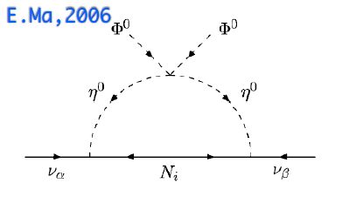
Possible Origin: Loop-Induced
One-Loop:
Zee Model
Ma Model
2 Higgs doublets +
3 EW neutral fermions
2 Higgs doublets +
1 charged singlet
Ma, 2006
Zee, 1981

Slide 16
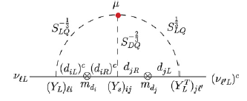
Possible Origin: Loop-Induced
Two-Loop:
Zee-Babu
Colored Zee-Babu
Colored version of
Zee-Babu
1 singly charged singlet +
1 doubly charged singlet
Kohda, et al, 2012
Cheng & Li, 1980; Zee, 1985;
Babu, 1988

Slide 17
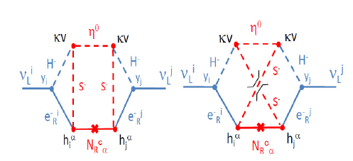
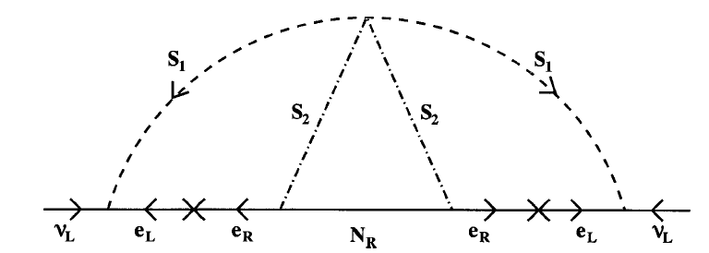
Possible Origin: Loop-Induced
Three-Loop:
Krauss, et al, 2003
Aoki, et al, 2009
2 Higgs doublets +
1 charged singlet + 3 RH neutrinos
2 Higgs doublets +
1 charged singlet +
1 real scalar singlet +
2 RH neutrinos
Krauss, et al, 2003;
Cheung & Seto,04;
Chen, et al, 2014

Slide 18


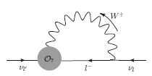

A Class of Models:EFT Viewpoint
Effective Operator
C.-Q. Geng, DH, L.-H. Tsai, Q. Wang JHEP 1508(2015) 141
EW Breaking
totally determine (m_{ν})_{ab}

Slide 19

EFT: Neutrino Masses
Now assume C_{ab} are of similar order, and notice the mass hierarchy in charged leptons
Generically, it is expected:
Approximation:
Normal Hierarchy
S. Pascoli, S.T. Petcov
and L. Wolfenstein, 2002
PDG, 2014

Slide 20

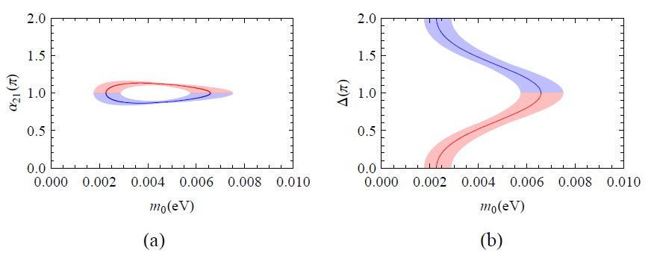
EFT: Neutrino Masses
With the standard parametrization of the PMNS matrix, the constraint can be transformed to
where
C.-Q. Geng, DH and L.-H. Tsai, EPJC 75 (2015) 11, 557

Slide 21
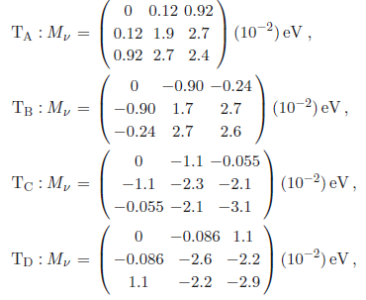
EFT: Neutrino Masses
For the CP conserving case, we can have four solutions

Slide 22
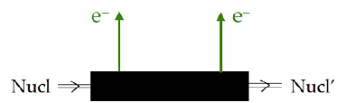
EFT: 0νββ Decay
Note that
breaks the lepton number U(1) symmetry by 2 units
Traditional smoking gun for LNV is neutrinoless double beta (0νββ) decay.

Slide 23
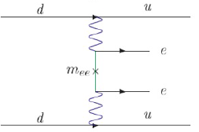
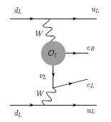
EFT: 0νββ Decay
Usually, one has the Majorana-mass insertion contribution. But can induce another mode
Mass-Insertion
O₇-Insertion
<p> ~100 MeV: typical momentum transfer in exp.

Slide 24
EFT: 0νββ Decay
The neutrino mass can be estimated with
Mass-Insertion
O7-Insertion
with
<p> ~100 MeV
In this class of models, 0νββ decays are dominated by O7 mode

Slide 25
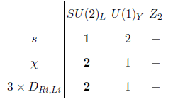
A Model with Dark Matter
General Idea: expanding O₇ with an one-loop diagram
New Particle Content:
C.-Q. Geng, DH, L.-H. Tsai, Q. Wang JHEP 1508(2015) 141
Break Lepton Number by 2 units
Relevant Lagrangian

Slide 26
Importance of Z₂ symmetry
Note that the introduction of Z₂ symmetry guarantees the lightest neutral Z₂ –odd state in χ would be dark matter candidate.
Connect Neutrino to DM physics

Slide 27

A Model with Dark Matter
After EW symmetry breaking
mixing between two singly-charged scalars
mass splitting between neutral scalars
Physical parameters
where λ_{L} characterizes coupling of neutral scalars to SM Higgs

Slide 28
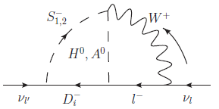
A Model with Dark Matter
Neutrino Masses: 2-loop
C.-Q. Geng, DH, L.-H. Tsai, Q. Wang
JHEP 1508(2015) 141
Mass Structure
Nonzero Mixing
Need Large Mass Diff.
I_{i1,2} ~ O(1)

Slide 29
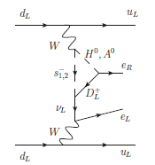
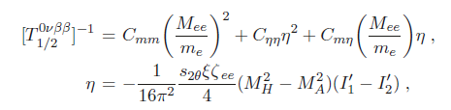



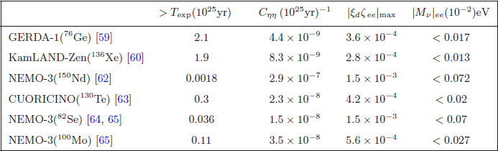
A Model with Dark Matter
Neutrinoless Double Beta Decay
C.-Q. Geng, DH, L.-H. Tsai, Q. Wang
JHEP 1508(2015) 141
where I_{1,2} loop integrals for S⁺_{1,2}.

Slide 30
Dark Matter Properties
Due to Z₂ symmetry, the lightest neutral scalar can be DM candidate. In our study, we assume it is H⁰.
Since the mixing s_{θ} is assumed to be small ~O(0.1), the DM property is very similar to the one in the Inert Doublet Model.
Focus on DM low-mass region, , in which large H-A mass splitting is allowed
Higgs Resonance dominates the freezing-out cross section in order to accomodate the DM relic density.
Higgs exchange channel can also lead to sizeable spin-independent direct detection signal, thus constrained by LUX
R. Barbieri, et al (2006), L. Lopez Honorez & C. E. Yaguna (2010), A. Arhrib, et al (2013)

Slide 31
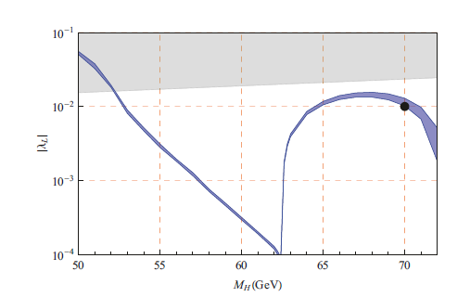
Dark Matter Properties
Allowed parameter space
where λ_{L} characterizes coupling of DM to SM Higgs

Slide 32

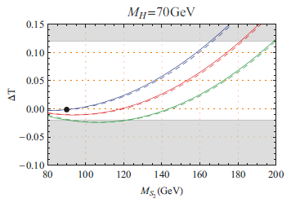
Constraints from EWPT
EW Precision Test – T parameter, constraining the Mass Spectra
where
PDG:
(2σ C. L. )
Parameters:

Slide 33





Constraints from LFV
Most stringent LFV process is
Upper bound from MEG:
In our model, Z₂-odd particles give new contributions
where
Typically, < O(10⁻⁴).

Slide 34

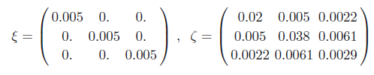
Benchmark Point
Parameters:
Type A Neutrino Mass Matrix

Slide 35
Remark of Z₂ symmetry
Problem: The usual EFT power counting tells us that the LNV would be dominated by the dim-5 Weinberg Operator
while O₇ would be suppressed by its higher power of cutoff
The Z₂ symmetry, together with previous particle content, makes O₇ (1-loop) prominent over the O_{W} (high-loop).
If Z₂ symmetry is absent, with s and χ,
the one-loop Zee’s model dominates,
realizing O_{W}.

Slide 36
Conclusion
In this talk, we study a particular class of loop-induced neutrino mass models from EFT viewpoint and construct a specific model with DM
Normal hierarchy is predicted;
A large neutrinoless double decay is predicted;
For the model, the related dark matter physics as well as constraints from LFV and EWPT are investigated.

Slide 37
Thanks for your attention!

Slide 38
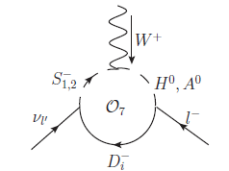
A Model with Dark Matter
Relevant Lagrangian:
The above Lagrangian breaks lepton number by 2 units, but due to Z₂ symmetry, it generates O₇ at one-loop level

Slide 39

Scalar Potential

